Slide 1
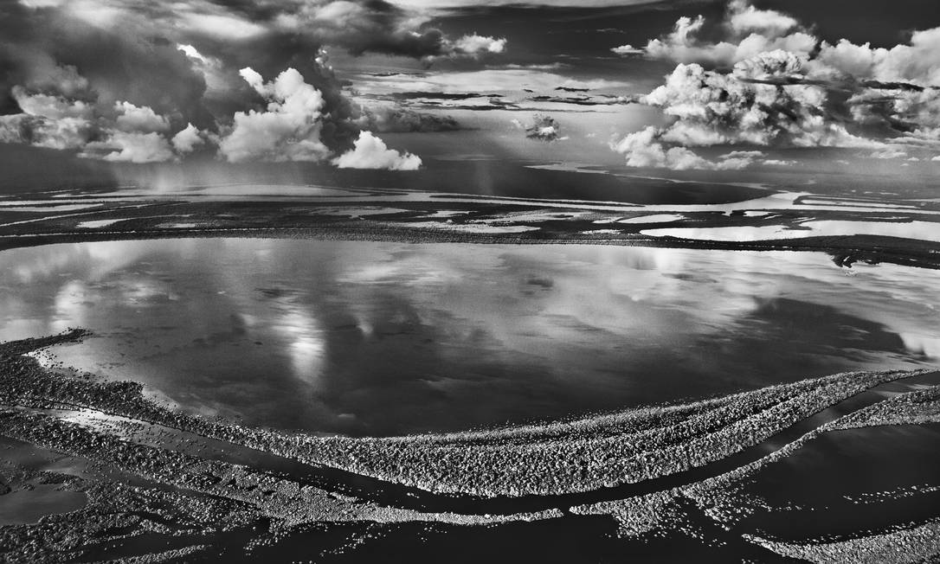
Monitoring deforestation inAmazonia: from visual interpretation to satellite time series analysis
Gilberto Camara
https://gilbertocamara.org
foto: Sebastiao Salgado

Slide 2
What is this talk about?
How best to use ML to measure tropical deforestation in Amazonia?
Is there an objective truth in EO?
What happens when EO is used for compliance?

Slide 3

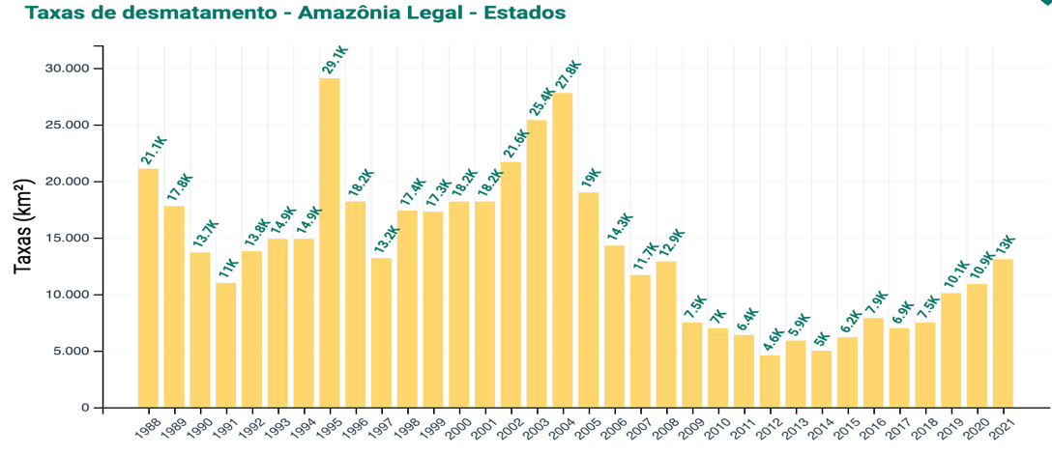
Deforestation in Amazonia: PRODES
Transparent and authoritative data: REDD+ funds (US$ 1,3 billion), decision-makers (Brazil’s NDC), researchers (1,000+ papers)

Slide 4



EO for compliance
How good must EO deforestation maps be for compliance enforcement?

Slide 5


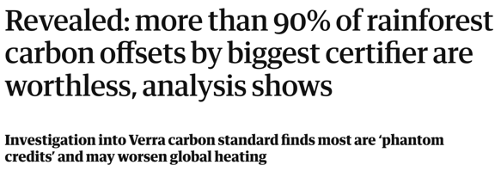
EO for compliance

Slide 6

EU deforestation-free goods regulation
(31) EU Observatory on deforestation, forest degradation, changes in the world’s forest cover and associated drivers to better monitor changes in the world’s forest cover and related drivers.
What happens if the EU Observatory produces bad results?

Slide 7
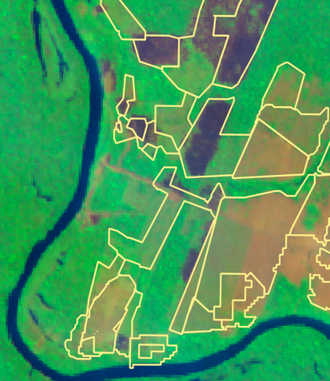
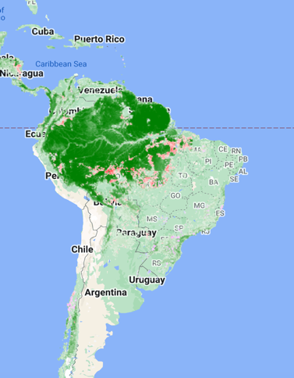

Local, global or glocal?

Slide 8
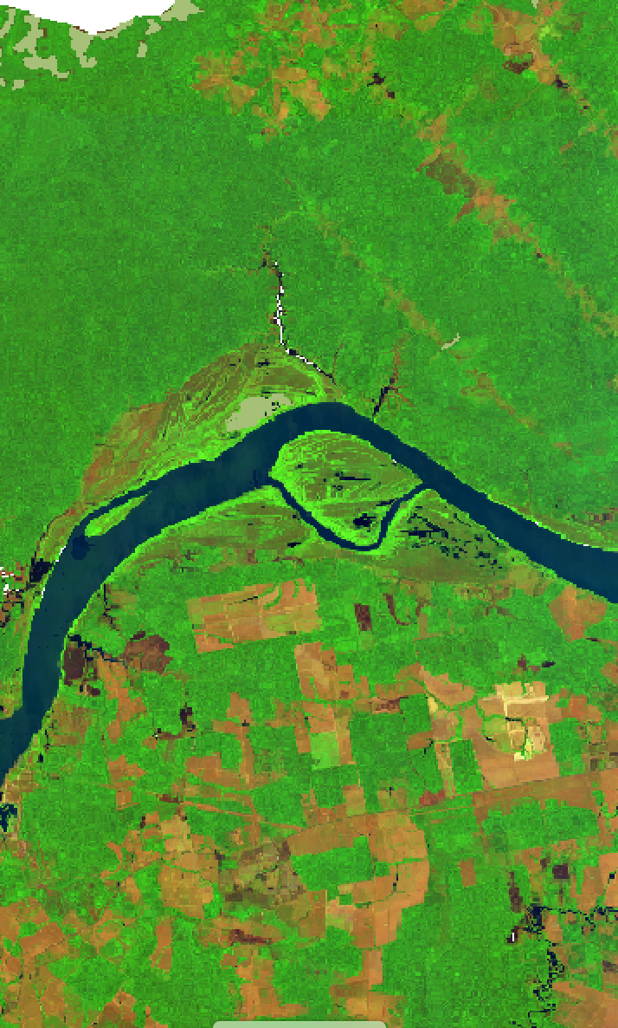
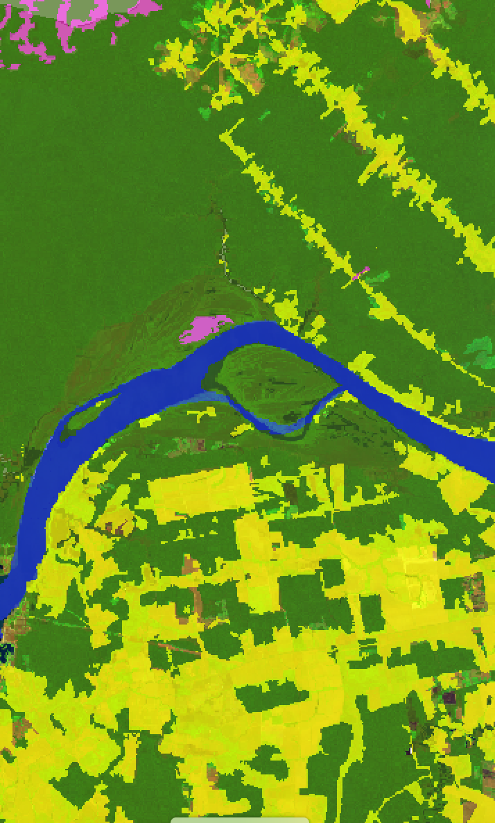
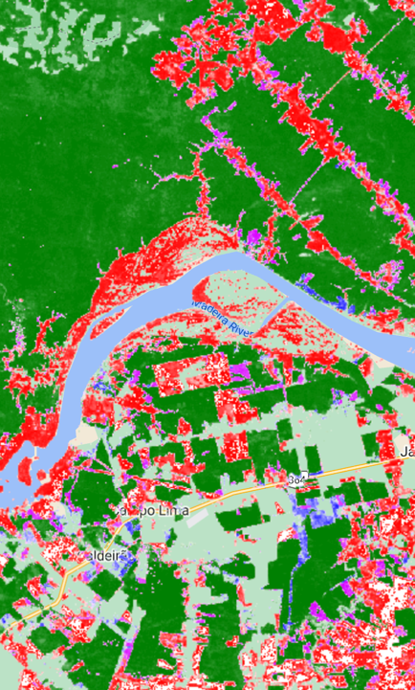
Sentinel-2 (2021)
PRODES (2021)
GLAD (2000-2020)

Slide 9
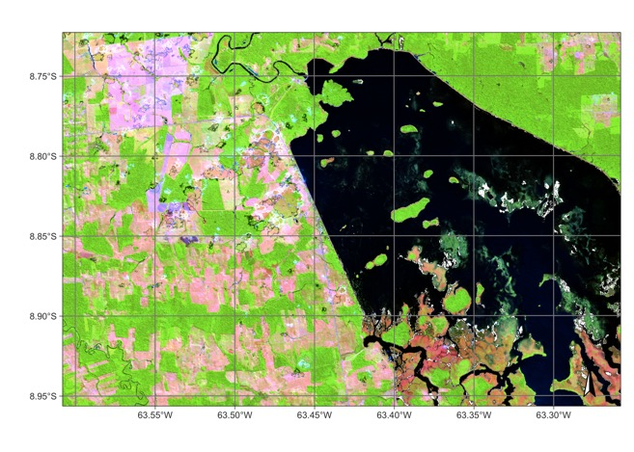
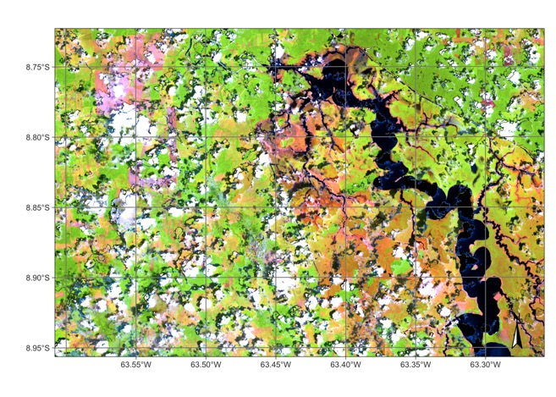
What’s in an image time series?
Searching for changes instead of searching for content. (Camara et al., “What’s in an image?”, COSIT 2001)

Slide 10
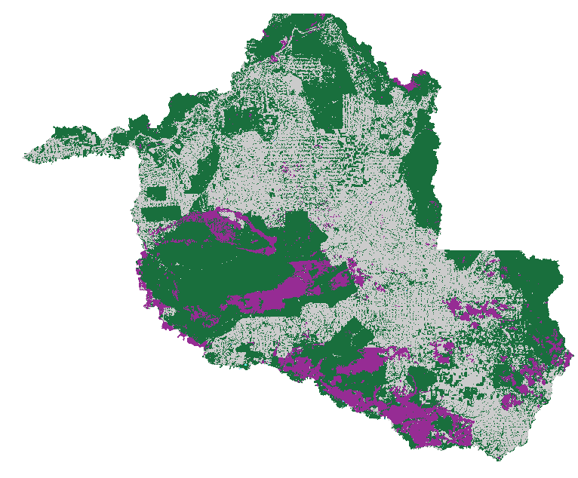
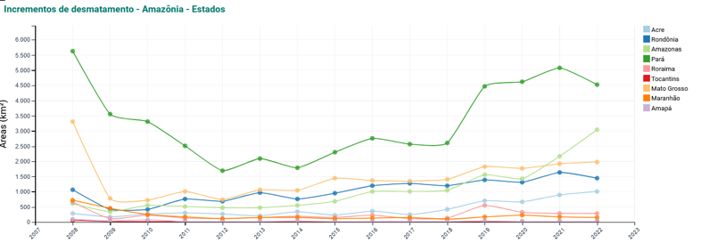
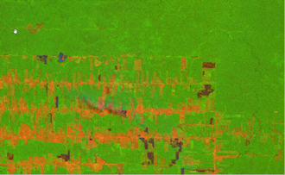
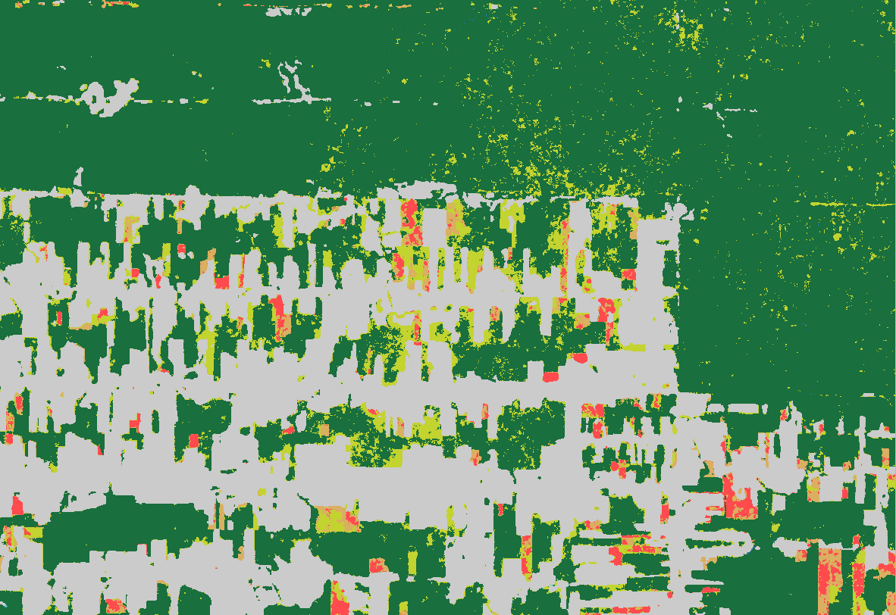
Deforestation in Rondônia
~238.000 km²
Sentinel 2A composição R11G8B2

Slide 11
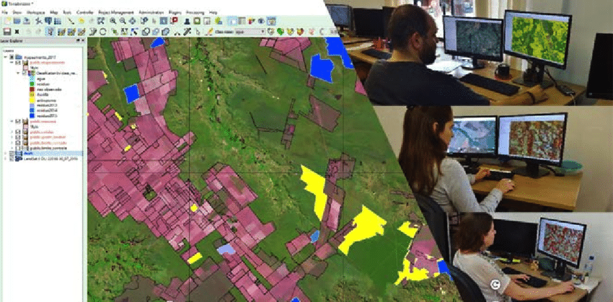
Visual interpretation is hard for ML to beat…

Slide 12
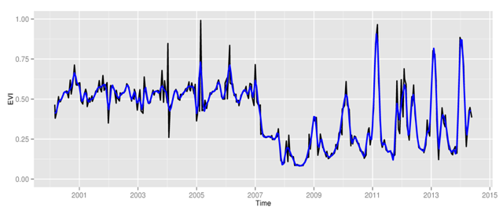
Space first, time later or time first, space later?
Space first: classify images;
compare results in time
Time first: classify time series;
join results to get maps
graphics: V Maus, author

Slide 13


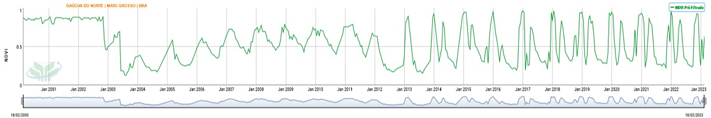


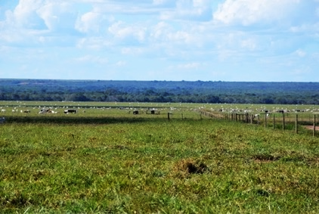




Time series indicate change
Desmatamento
Floresta
Pastagem
Culturas Agrícolas Temporárias
Embrapa Agricultura Digital
13

Slide 14
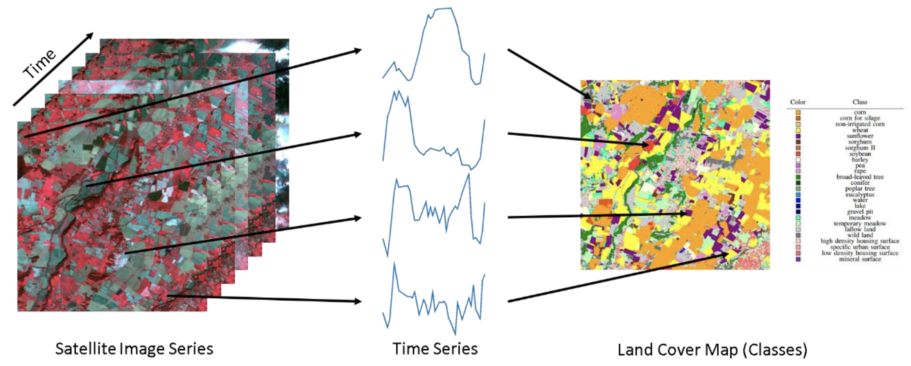
Big EO data: access to image time series
image: F Petitjean, Monash Univ
Notes:
Sits is an R package for Satellite Image Time Series Analysis for Earth Observation Data Cubes.
This package provides a simples API for a complete and complex workflow for land classification from big EO data sets.
It provides funcionalities to:
Create and define earth observation data cubes
Assess and improve land use and cover samples using neural network and Self-Organizing maps (SOM)
Train different kinds of machine learning methods using land use and cover samples
Classify the data cube using the trained model.
Perform some kind of post-processing (such as smoothing) to generate the final map.
Spatial smoothing methods remove outliers from the classification.

Slide 15


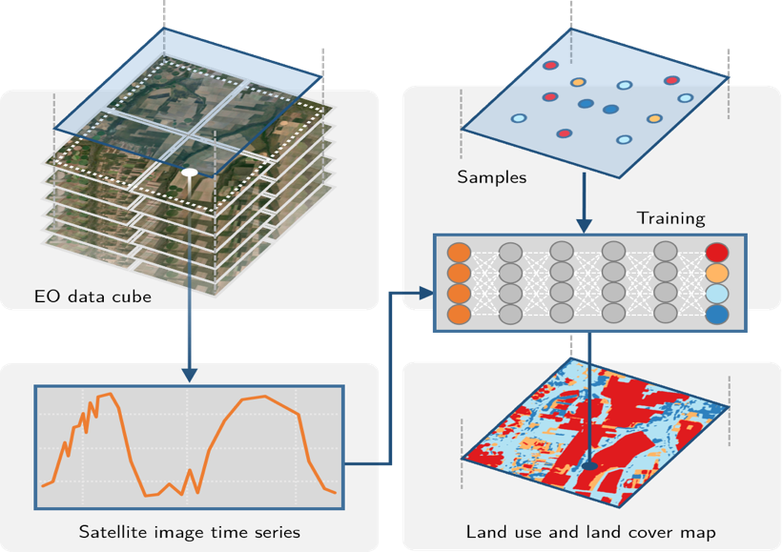
SITS workflow
Notes:
Uma das formas de classificar uma série temporal é passando os dados da série temporal diretamente para algoritmos de aprendizado de máquina.
Primeiramente, as séries temporais devem vir de algum lugar. Conceptualmente, as séries temporais vem de cubos de dados de observação da Terra, que são imagens organizadas que representam as dimensões espaciais (x e y) e a temporal.
Usando amostras que indicam um intervalo de datas e uma localização espacial associados a uma classe de uso e cobertura da Terra, podemos treinar modelos de aprendizado de máquina para gerar mapas de uso e cobertura.

Slide 16


Big EO data analysis in practice
Obtain and harmonise ARD
Collect training data (in-situ)
Put ARD in a cloud collection
Quality control on training data
Build a data cube
Select ML method
Train data set
Classify data
Smoothen data
Label map
Access accuracy

Slide 17
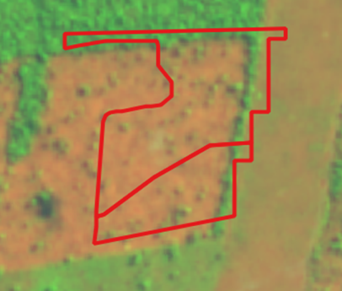
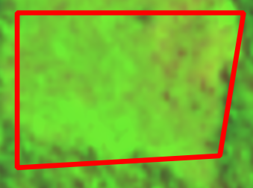
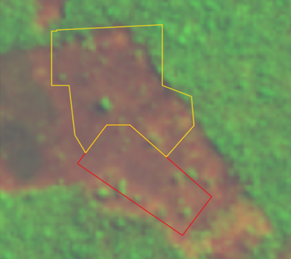
Clear Cut Bare Soil
Clear Cut w/ vegetation
Clear Cut w/ fire
How to measure these events?

Slide 18
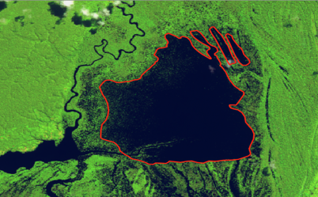
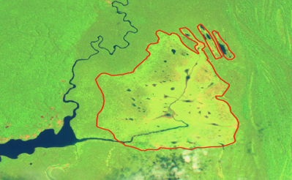
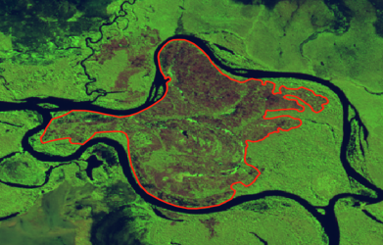
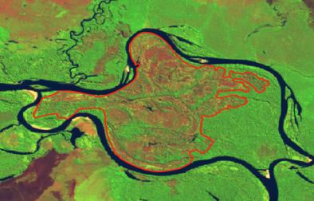
Seasonally-flooded areas
Riparian forests

Slide 19
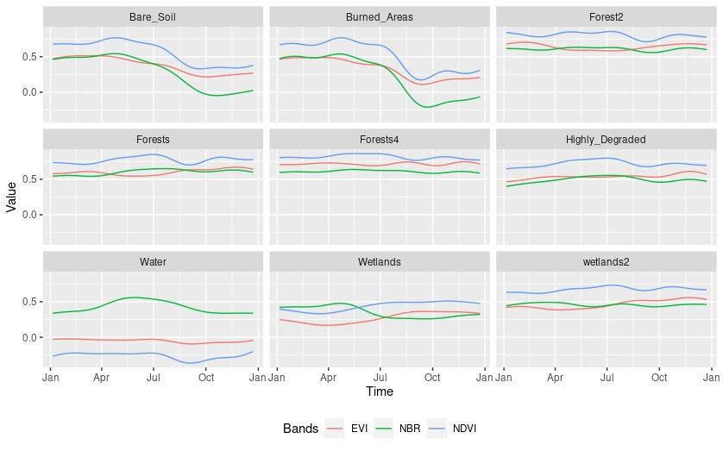
Time series patterns
Clear Cut Bare Soil
Clear Cut Fire
Mountain Side Forest
Forest
Riparian Forest
Clear Cut Vegetation
Water
Seasonally flooded
Wetlands

Slide 20
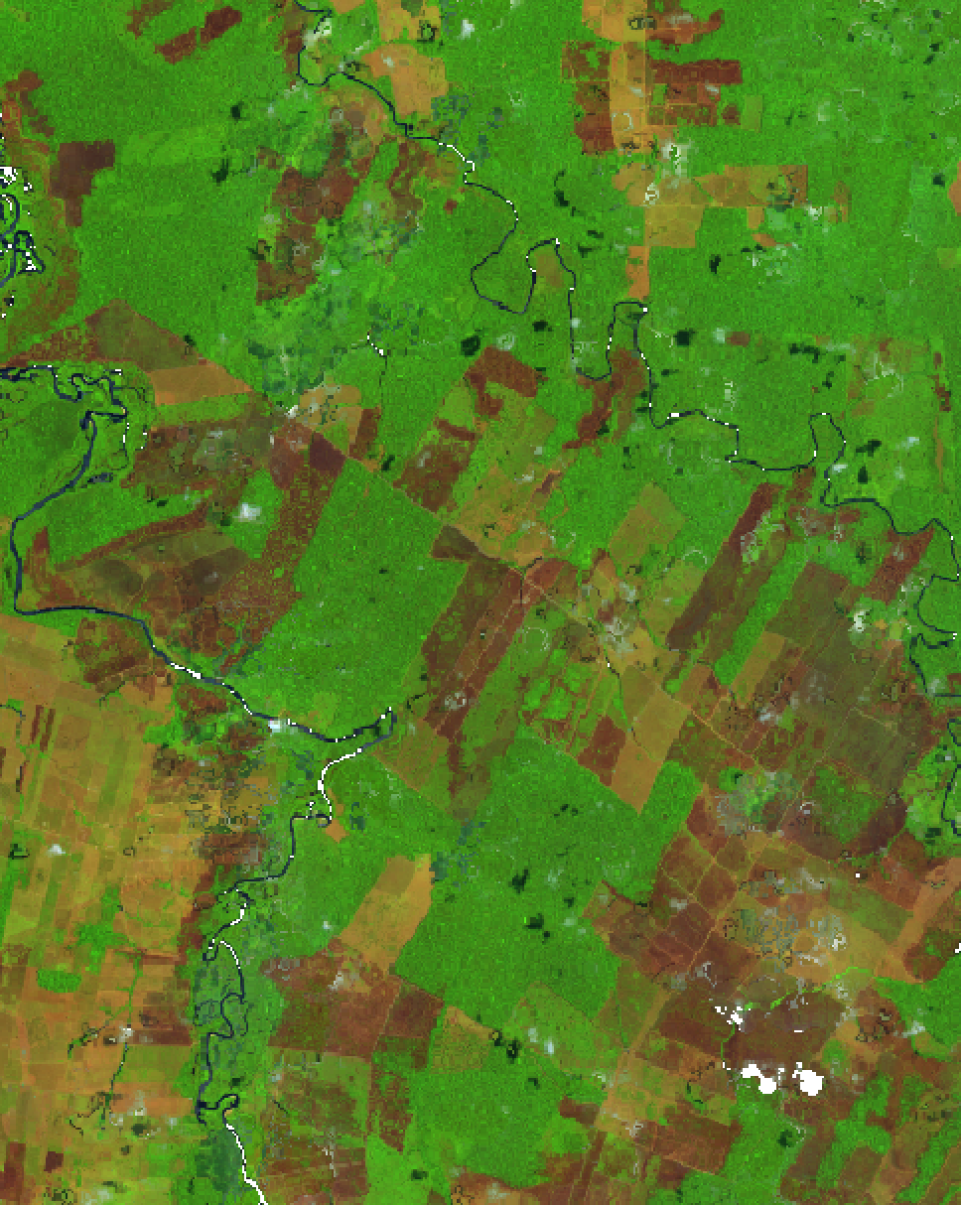
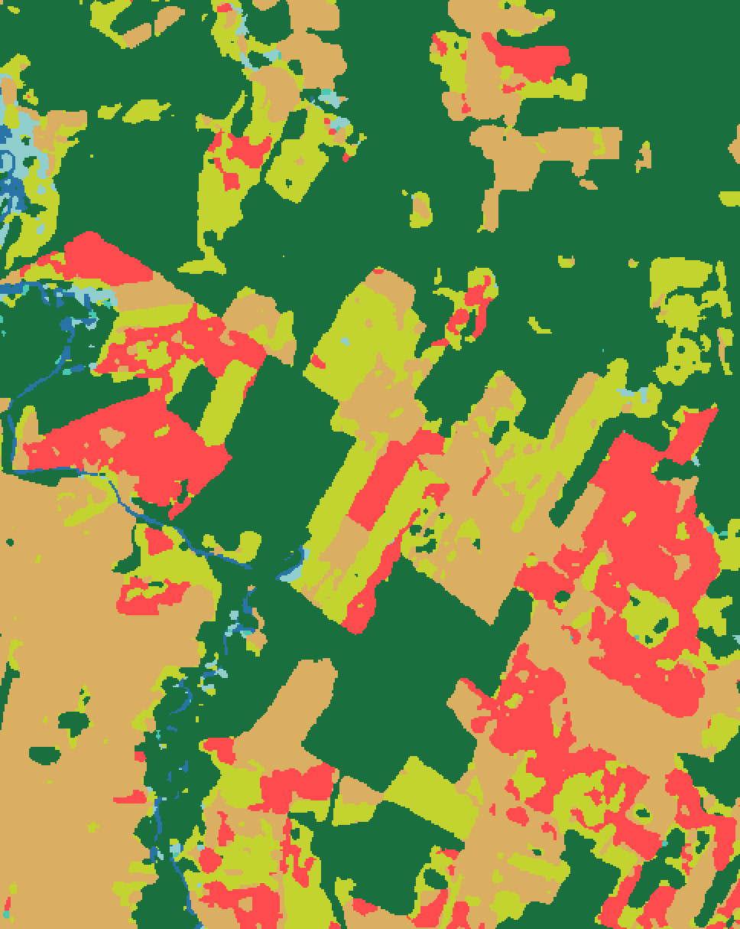
Sentinel-2 (10/2022)
SITS map (2022)

Slide 21
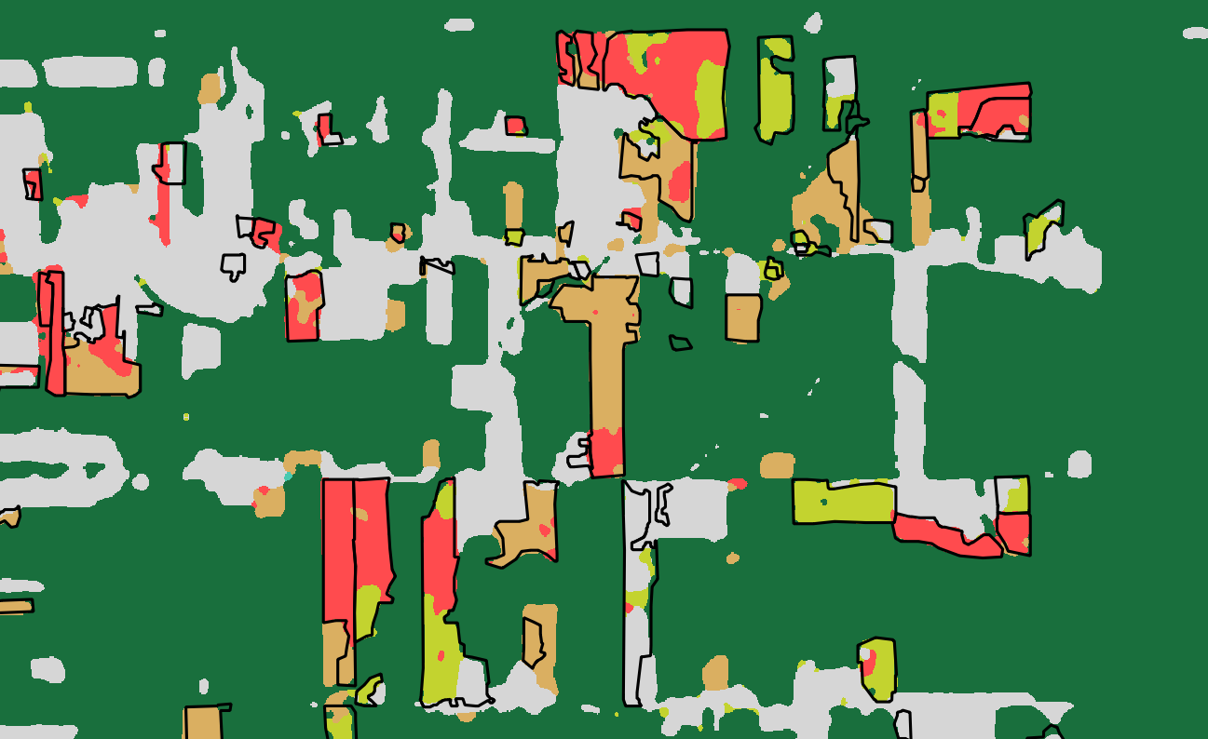
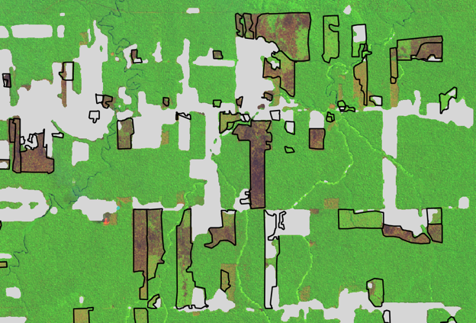
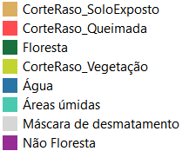
Comparison SITS and visual interpretation
August/2022
95% agreement

Slide 22
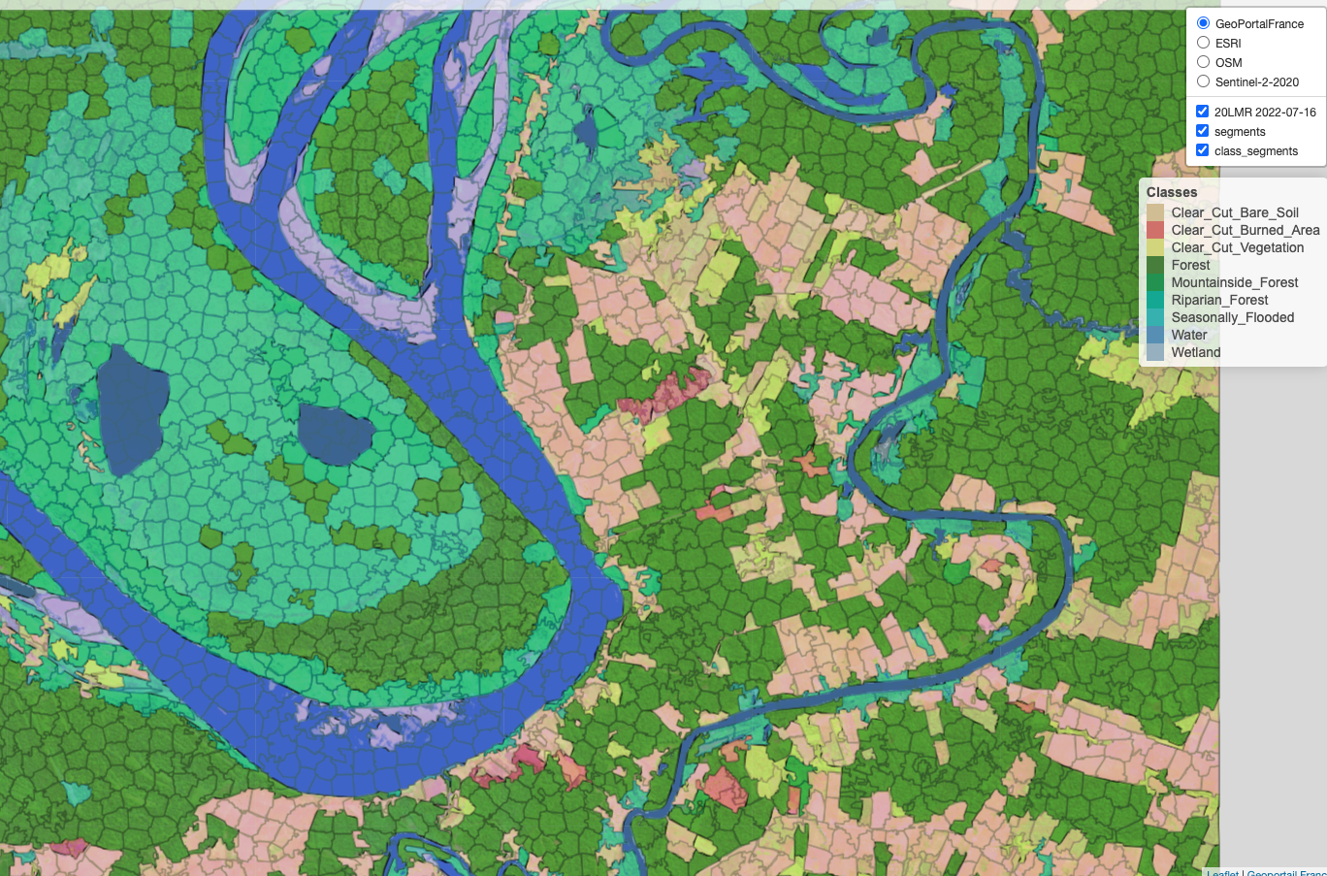
Object-based image time series analysis

Slide 23
What have we learned?
EO for compliance: high accuracy is crucial
No objective truth in ML for EO: training classes are context-dependent
Time-first, space-later: key to measure deforestation and LUCC

Slide 24





















Karine
Lúbia
Lorena
Michelle
Isabel
Charlotte
Ana Paula
Ana Rorato
Anielli
Lidia
Gleyce
Luciana
Gilberto
Felipe
Rolf
Pedro
Alber
João
Alex
Julio
Sadeck
Claudio
Mateus
Breno
Julio

